Slide 1
Lecture-2
Digitization and Recording
Notes:
CT_2003-11-27_E

Slide 2
Sound Frequency ranges
Normal humans hearing 20 Hz – 20,000 Hz
Human speech ~ 50 Hz – 8000 Hz
Standard phone circuits ~ 300 - 3000 Hz

Slide 3
How does tape recording differ from digital recording?
Analog (tape) recording
  Acquires a continuously varying signal
Digital recording
  Acquires a string of discrete numbers

Slide 4
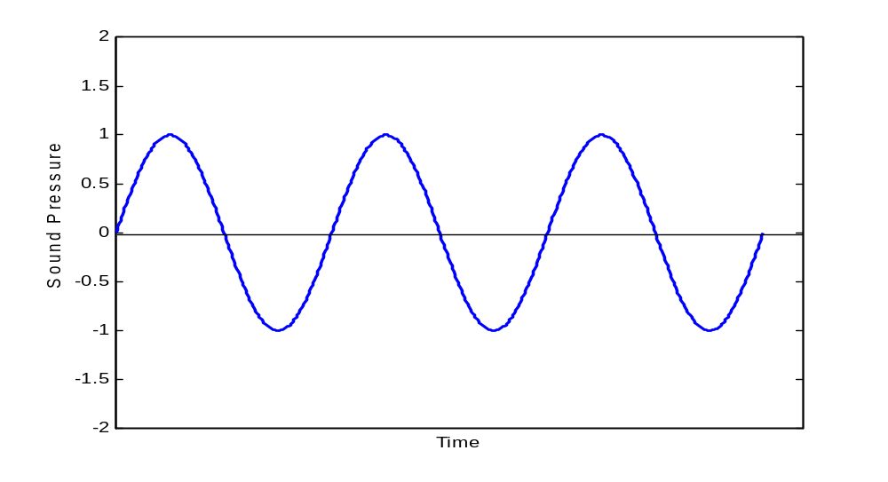
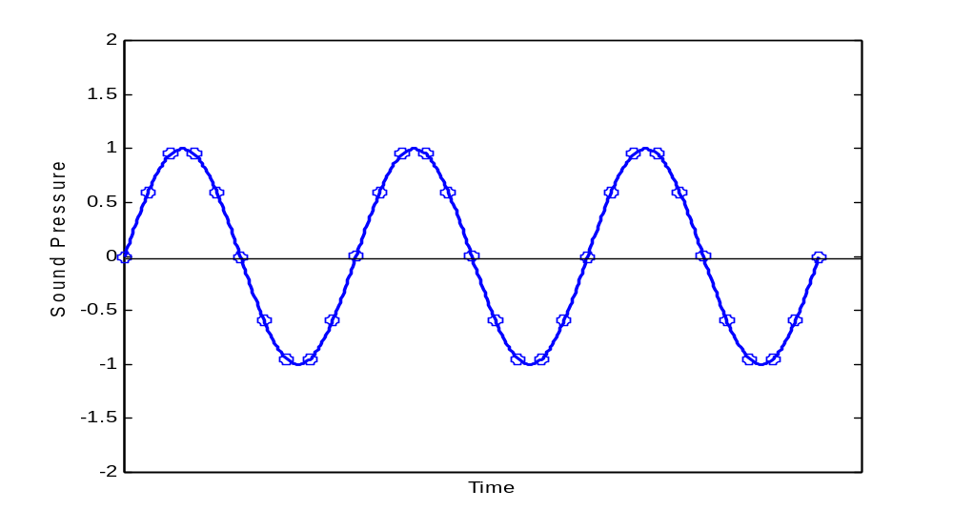
Analog (Continuous)
Digital (Discrete)

Slide 5
Digital Recording
Since sound is converted to a string of numbers, two issues have an influence on recording accuracy/fidelity
1. How often does the device “grab” a number?
Sampling rate/frequency
2. How much precision is used when number recording?
Quantization level
Copyright Tasko & Finan 2008

Slide 6
A DSP system
x(t)= A sin(2πft)
x(n)= A sin(2πnT)
{0,5,-1,10}
{2,5,10,100}
Analog
I/P
LPF
Anti-
Aliasing
filter
Sample
&
Hold
ADC
DSP
DAC
x(t)
x(nTs)
x(n)
y(n)
y(t)
Y’(t)
Sampling frequency(Fs)

Slide 7

Sampling
Where x(n) is the discrete-time signal obtained by taking samples of the analog signal x_{a}(t) every T second. T=1/Fs where Fs is the sampling rate
Analog signal x_{a}(t)
x(n)
Fs=1/T
x_{a}(t)
x(n)
t
0
1
2
3
Sampling Theorem: if the highest frequency contained in an analog signal x(t) is F_{max}=B and the signal is sampled at rate Fs>2F_{max}=2B, then x(t) can be exactly recovered from its sample values using the interpolation function.

Slide 8
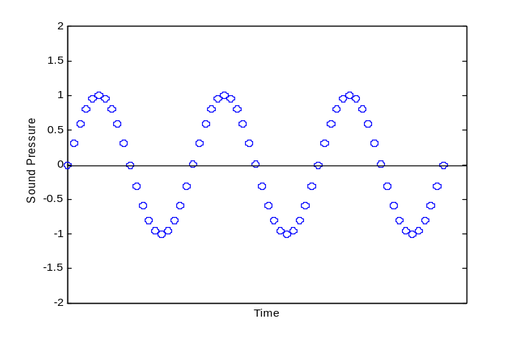
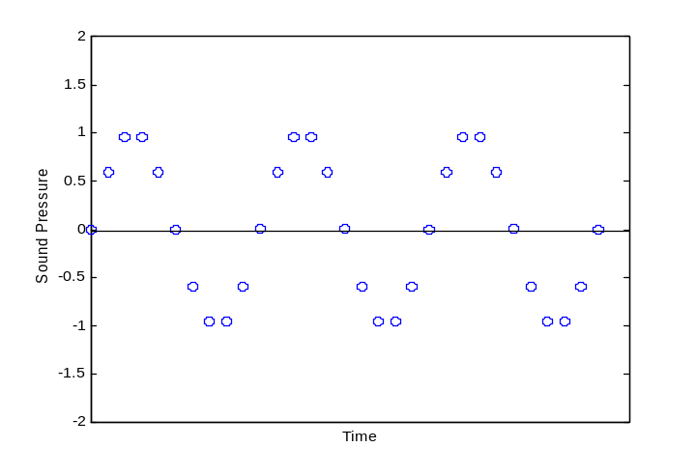
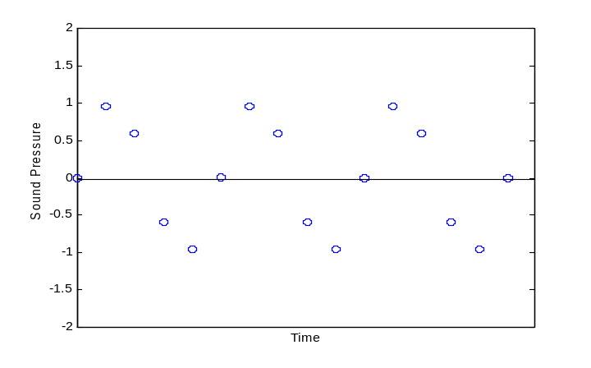
Sampling Rate
High
Low
Copyright Tasko & Finan 2008

Slide 9
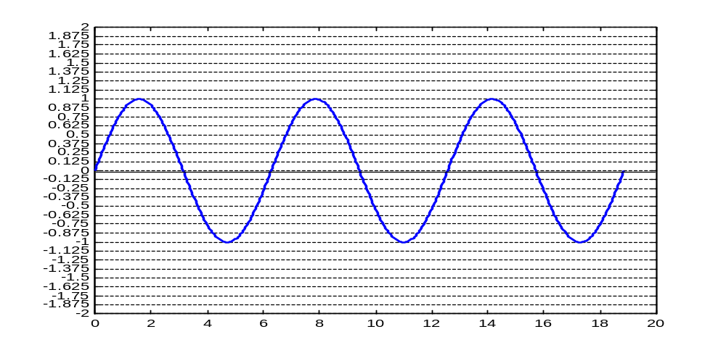
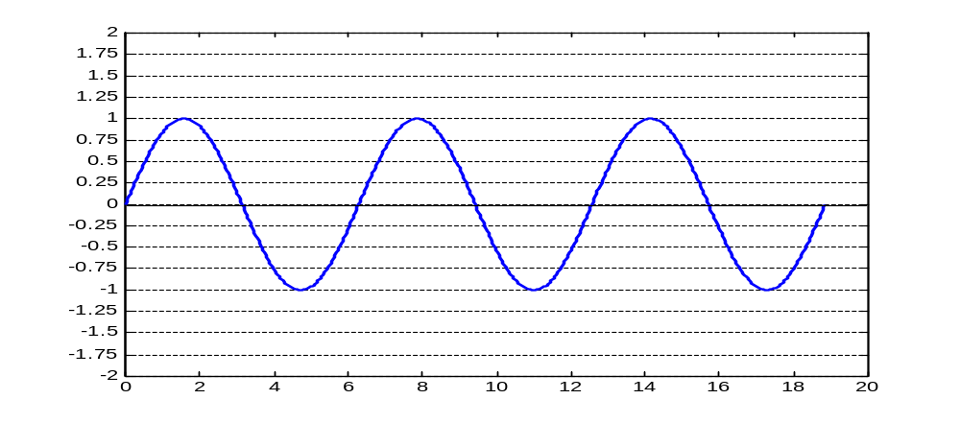
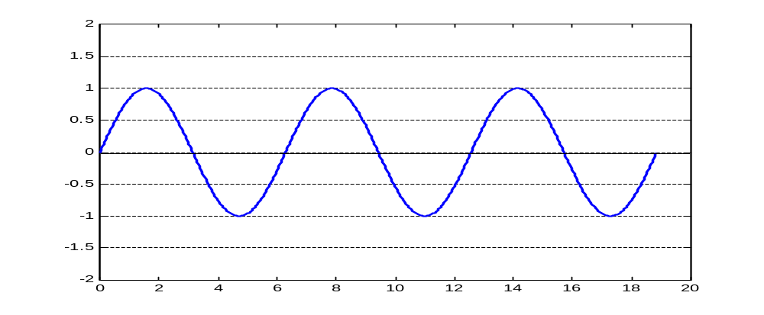
Quantization
High
Low

Slide 10
Quantization
Expressed in “bits”
↑ bits ~ ↑ # of marks on the “ruler” = greater precision
X bits/sample = 2^{x} possible units of measure
For example,
  2 bit = 4 levels
  4 bit = 16 levels
  8 bit = 256 levels
  12 bit=4096 levels
  16 bit = 65536 levels

Slide 11
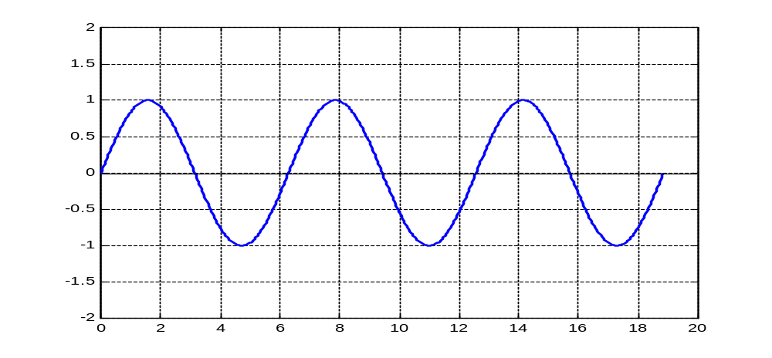
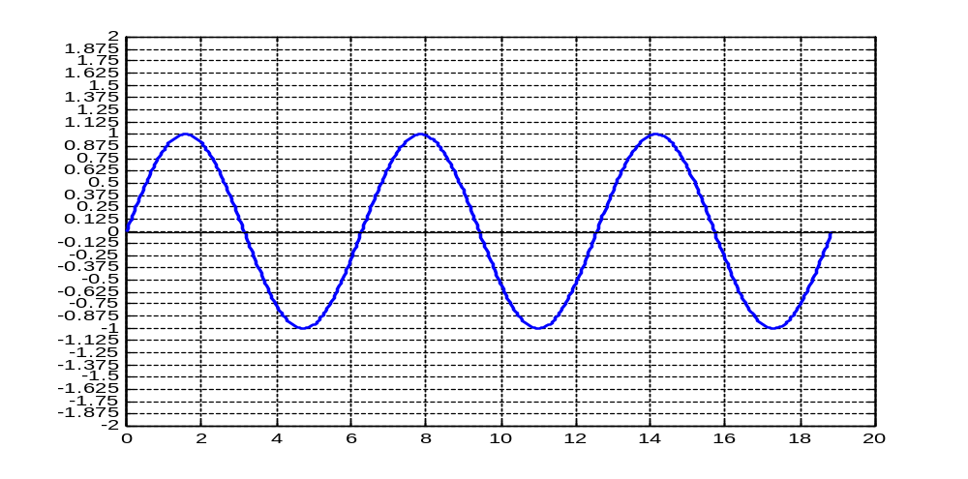
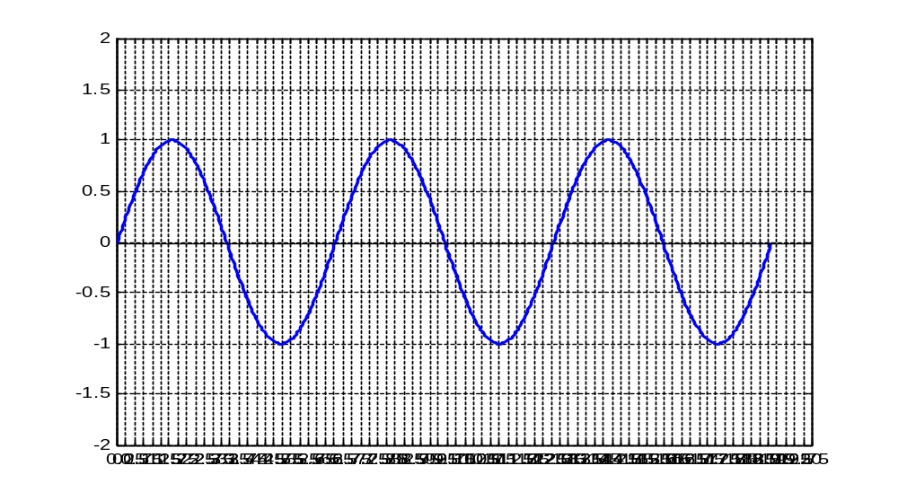
Low sampling rate
Low quantization
Low sampling rate
High quantization
High sampling rate
Low quantization

Slide 12
Components of Sound Recording
Microphone
Amplifier
Digital Recording Device
Digitization of sound
Storing of sound as file
Playback ability
Amplifier-Speaker
Headset

Slide 13
Digital File formats
Mono vs. Stereo
Encoding (PCM, ADPCM, etc.)
File format
  .wav
  .nsp
  .mp3
  .mp4
  .wma
  .dss
  .au
  etc

Slide 14
Digital File formats
Uncompressed Formats (Lossless)
All samples are retained
What you record is what you get
Most common format
  “.wav” (PCM)
Compressed Formats
algorithm used to reduce file size yet maintain good audibility
Driven, in part, by music industry
Common Formats
  .mp3, .wma, .dss
Effect on speech samples is not well known

Slide 15
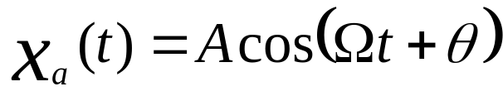
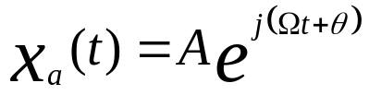
Concept of frequency in continuous-time and Discrete-time signal
Continuous sinusoidal Time Signal
For every fixed value of the frequency F x(t) is periodic
Continuous time sinusoidal signal with distinct frequencies are themselves distinct.
Increase the frequency result in increase in the rate of oscillation of the signal → more period are included.
Complex exponent from

Slide 16

Discrete time Sinusoidal
A discrete time signal is periodic if its frequency f is a rational number
Discrete time sinusoidal whose frequency are separated by an integer multiple of 2π are identical
The highest rate of oscillation in a discrete time sinusoidal is attained when w= π or(- π).

Slide 17
Discrete and Digital signal
Direct delta representation and unit sample representation
x(n)
Unit
sample
1
*
*
*
*
*
*
*
{1,0,0,0,…….}
0 1 2 3 4 5 6
x(n)
Unit
step
1
*
*
*
*
*
*
*
{1,1,1,1,…….}
0 1 2 3 4 5 6
Cosine
wave
x(n)
1
*
*
*
*
*
*
*
{1, cos(w₀T_{s}), cos(2w₀T_{s}),….}
x(n)={cos(w₀nT_{s})}
0 1 2 3 4 5 6

Slide 18
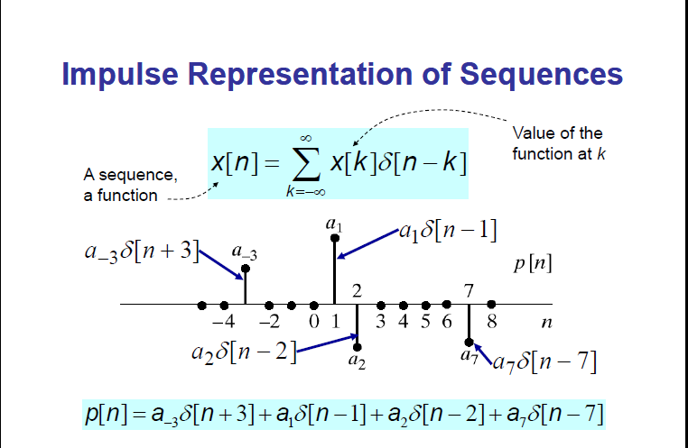

Slide 19
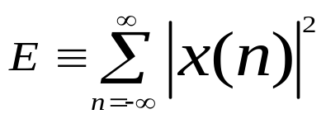
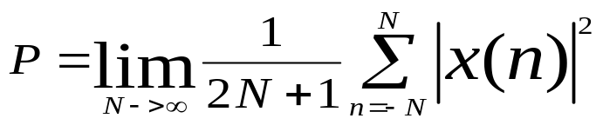
Classification of Discrete time signal
Energy signal and power signal: If E is the energy of a signal x(n)
If E is finite then x(n) is called an energy signal
Many signal possesss infinite energy, have a finite avarage power P. The avarage power define as:
If P is finite and nonzero then the signal is called a power signal
Periodic and aperiodic signal: a signal x(n) is periodic with period N if and only if x(n+N)=x(n) for all n
The smallest value of N for which holds the above equation is called fundamental period.
If there is no value of N that satisfies the above equation then the signal is called aperiodic signal.
Symmetric and antisymmetric signal: a real-valued signal x(n) is called symmetric if x(-n)=x(n)
On the other hand a signal x(n) is called antisymmetric if x(-n)=-x(n)

